Slide 1

Industry 4.0 Virtual Reality and Augmented Reality
Prepared by: P. Sunil

Slide 2
Virtual Reality
Virtual reality is a technology that uses software to generate realistic images, sound and other sensations that replicate real world environment.
A user can interact and manipulate with virtual objects of virtual world with the help of specialized devices like display screens or other devices.

Slide 3
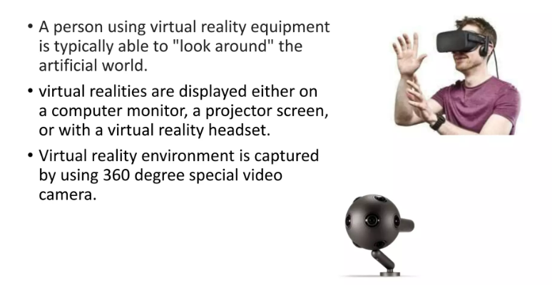
Virtual Reality

Slide 4
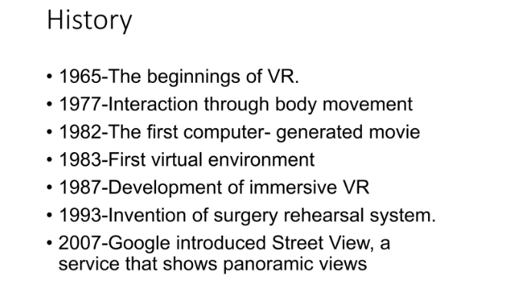

Slide 5
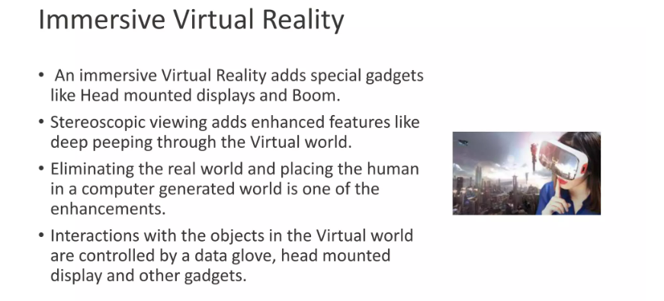

Slide 6
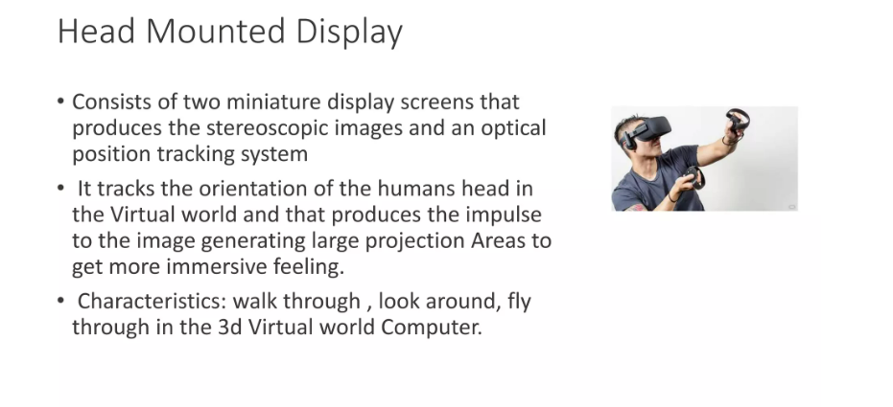

Slide 7
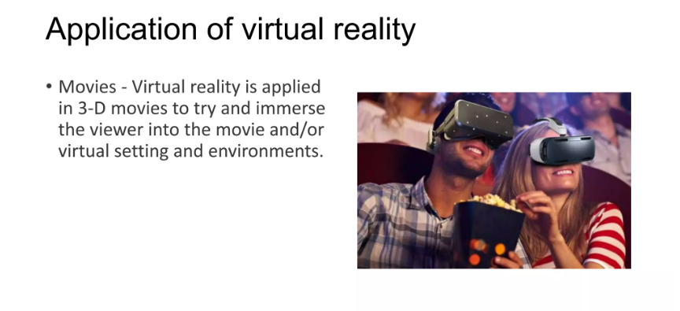

Slide 8
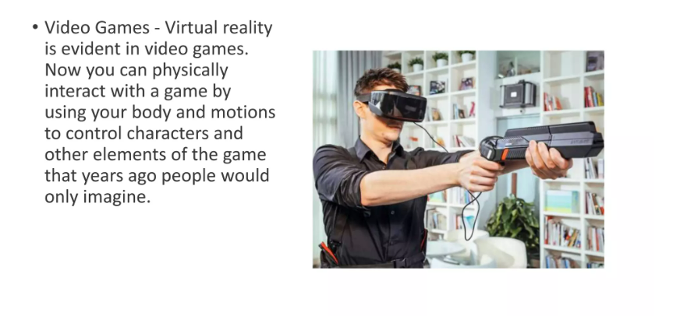
Applications of VR Cont...

Slide 9
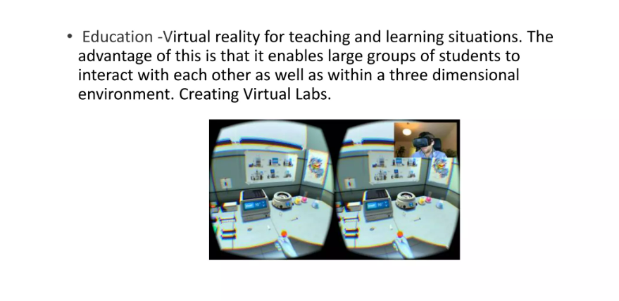
Applications of VR Cont...

Slide 10
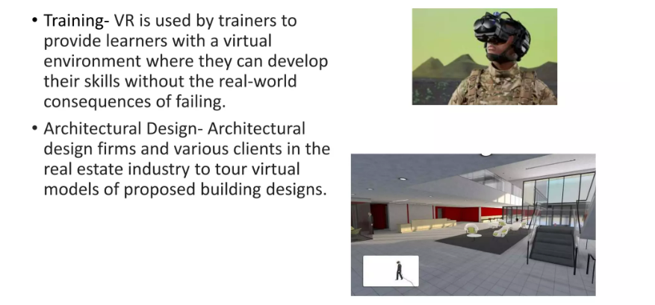
Applications of VR Cont...

Slide 11
How Virtual Reality Works?
Virtual Reality tricks your brain into believing you are in a 3D world.
VR does this is with the stereoscopic display.
It works by displaying two slightly different angles of the scene to each eye, simulating depth.

Slide 12
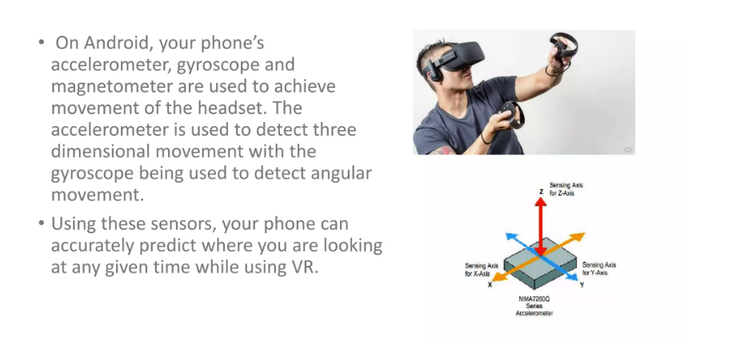

Slide 13
Advantages of Virtual Reality
It creates a realistic world
It enables users to explore places
It makes education easier and provides comfort

Slide 14

Augmented Reality
A combination of real scene viewed by a viewer and a virtual scene generated by a computer that augments the scene with additional information.

Slide 15
Augmented Reality
Augmented relaity adds virtual computer-generated objects, audio and other sense enhancements to a real world environment in real time.
The goal of augmented reality is to create a system such that a user cannot tell the difference between the real world and the virtual augmentation of it.

Slide 16
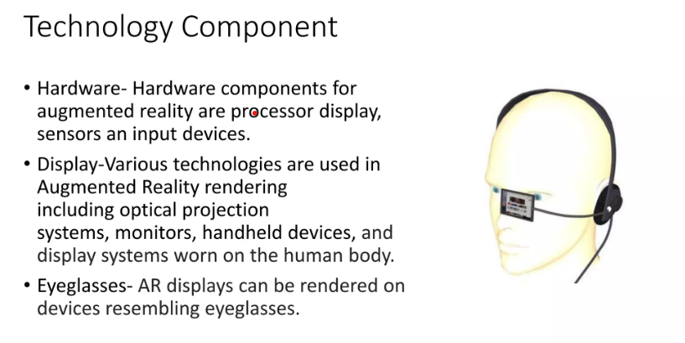

Slide 17
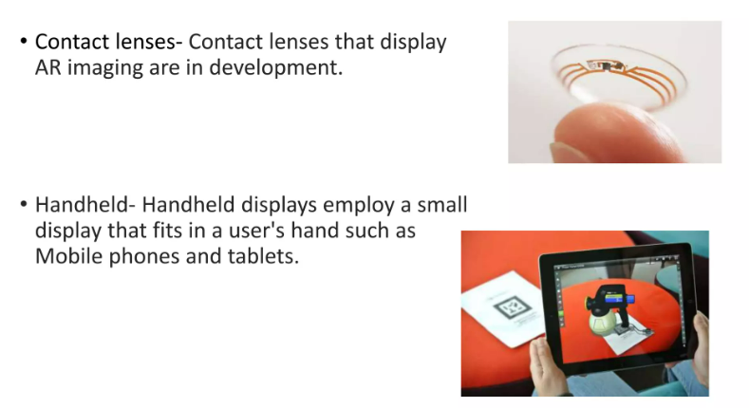
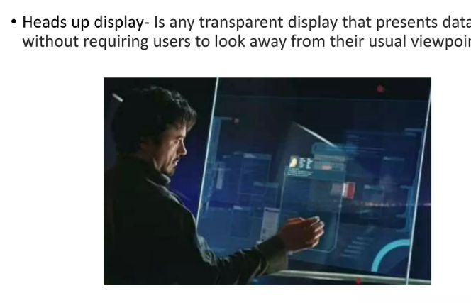
Technology Components Cont...

Slide 18
Applications of AR
Medical
Entertainment
Military training
Engineering design
Robotics and Telerobotics
Manufacturing, Maintainance and repair

Slide 19
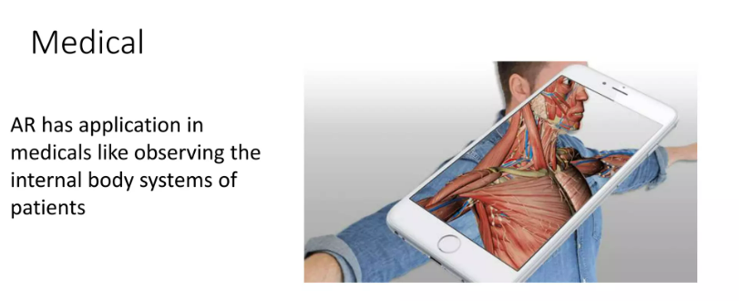
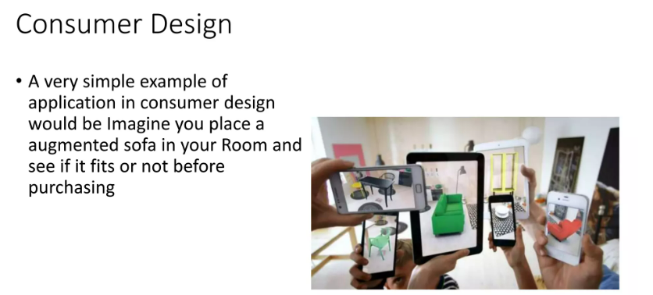
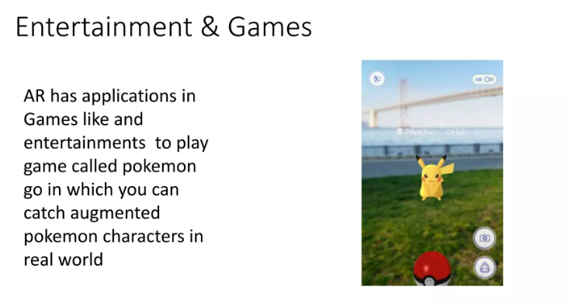
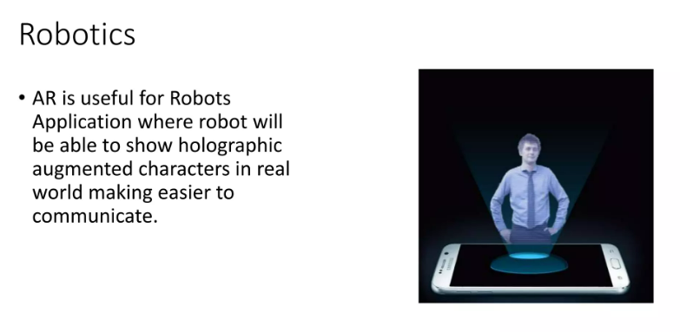
Applications of AR Cont...

Slide 20
Advantages & Disadvantages of AR
Advantages
Can increase knowledge and information
People can shareexperiences with each other in realtime over long distances
Things come to life on people’s mobile
Games can provide even more ‘real’ experience
Disadvantages
Production is expensive
Lack of privacy
Difficult to maintain augmented reality systems
Low performance level

Slide 21
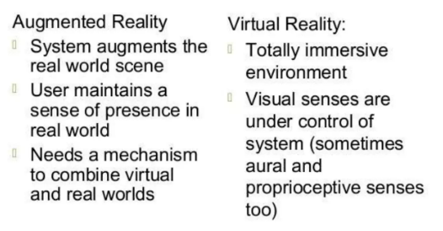
Augmented Reality vs Virtual Reality

Slide 22
Conclusion
Virtual as well as Augmented reality has very strong potentials in future

